Slide 1

Open a coffee shop in paris

Slide 2

Where can i open a coffee shop in Paris?
Potential customers
Competition with other coffee shops
Place Activity
COMMERCIAL RENTAL PRICE

Slide 3
Data acquisition
- Features of coffee shops in Paris : name, latitude, longitude, postal code, city, address (retrieved with Foursquare API).
- Average commercial rental prices (in m² for each borough ): postal Code, average commercial rental prices( retrieved in this website: https://www.localcommercial.net/estimerloyer/38080/paris-20-arrondissement.html )
- Boroughs’s geometric informations : geometric coordinates for each Paris’ borough with a geoJSON file ( arrondissements.geojson downloaded in this page : shorturl.at/iuHQX )
- Paris’ venues : name, latitude, longitude, postal code, address, category ( retrieved with Foursquare API)

Slide 4
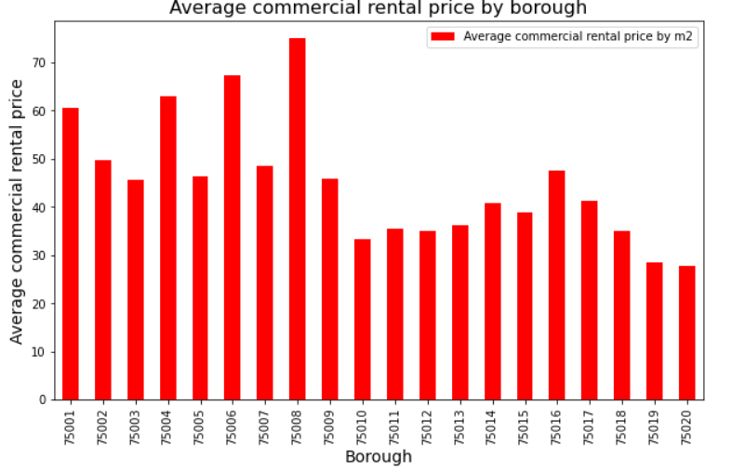
Average rental prices in m² per month for each borough
Boroughs 75001 to 75009: high and middle high prices.
Boroughs 75010 to 75020: middle and low prices.

Slide 5
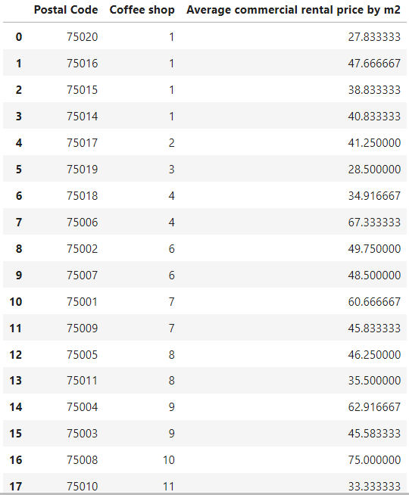
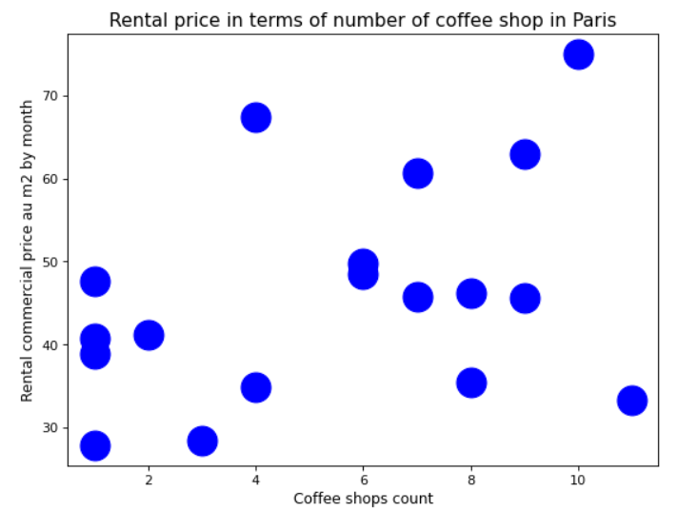
Average commercial rental prices depending on the number of coffee shops

Slide 6
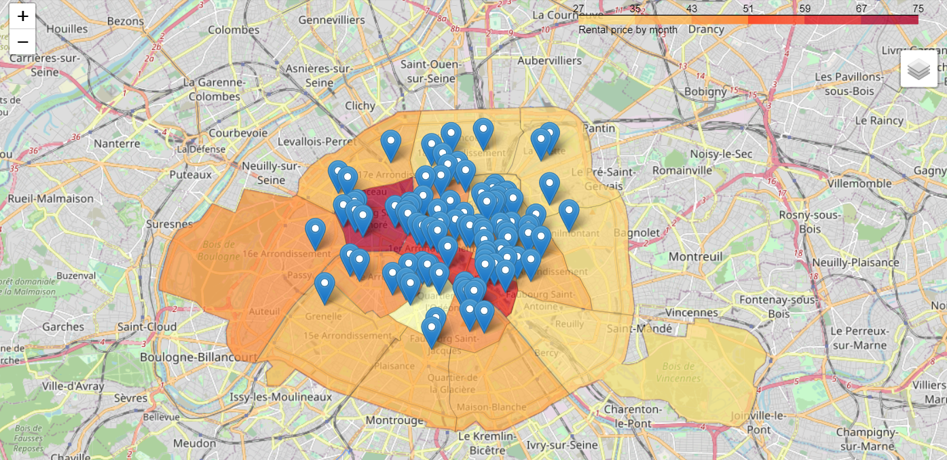
coffee shops and rental prices
Observations:
Highest prices at the center of Paris.
Middle and low prices close to Parisian suburb
Borough with highest and middle rental contain most coffee shop
Coffee shops work better at the center of Paris than in the boroughs close to parisian suburb

Slide 7
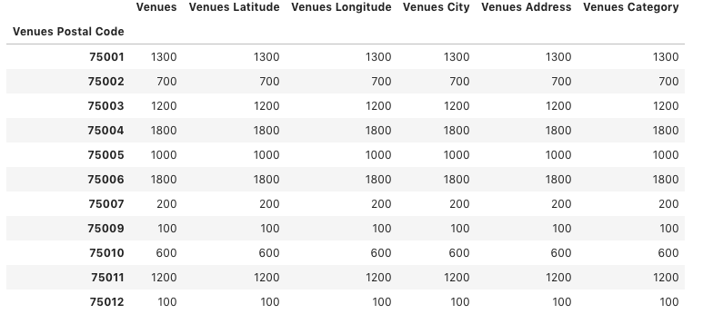
Activity of each borough
Observations:
5 very active boroughs : Paris 6, 4, 1, 3, 11
Many coffee shops in those boroughs
The more an area is active, more there will be many coffee shop in this area

Slide 8
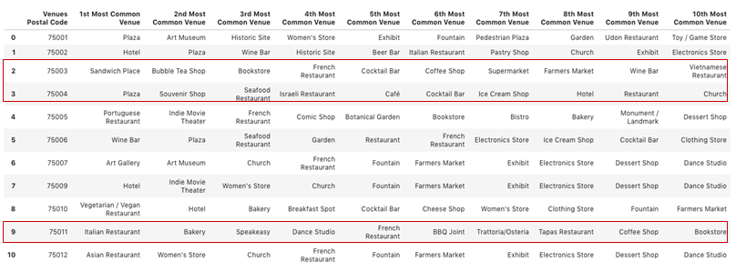
Top 10 most common venues per borough

Slide 9
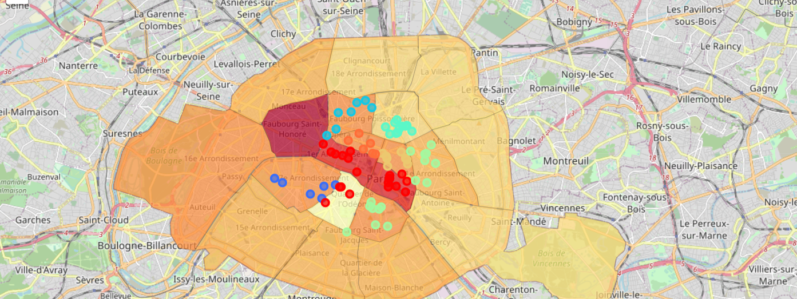
Map of clusters

Slide 10
Make your choice !
 | Price | Potential client | Coffee Venue | Coffee number | Active | Cluster
75001 | high | All kind | x | high | Very active | 0
75002 | middle | tourists | x | middle | active | 7
75003 | middle | Students/ workers | ✓ | high | Very active | 6
75004 | high | All kind | ✓ | middle | Very very active | 0
75005 | middle | Students/ workers | x | middle | Very active | 5
75006 | middle | All kind | x | middle | Very very active | 0
75007 | middle | tourists | x | middle | Not very active | 2
75008 | Very high | --------------- | x | high | --------------- | ---------------
75009 | Middle | tourists | x | middle | Not very active | 3
75010 | Middle low | tourists | x | high | active | 4
75011 | Middle low | Students/ workers | ✓ | middle | Very active | 5

Slide 11
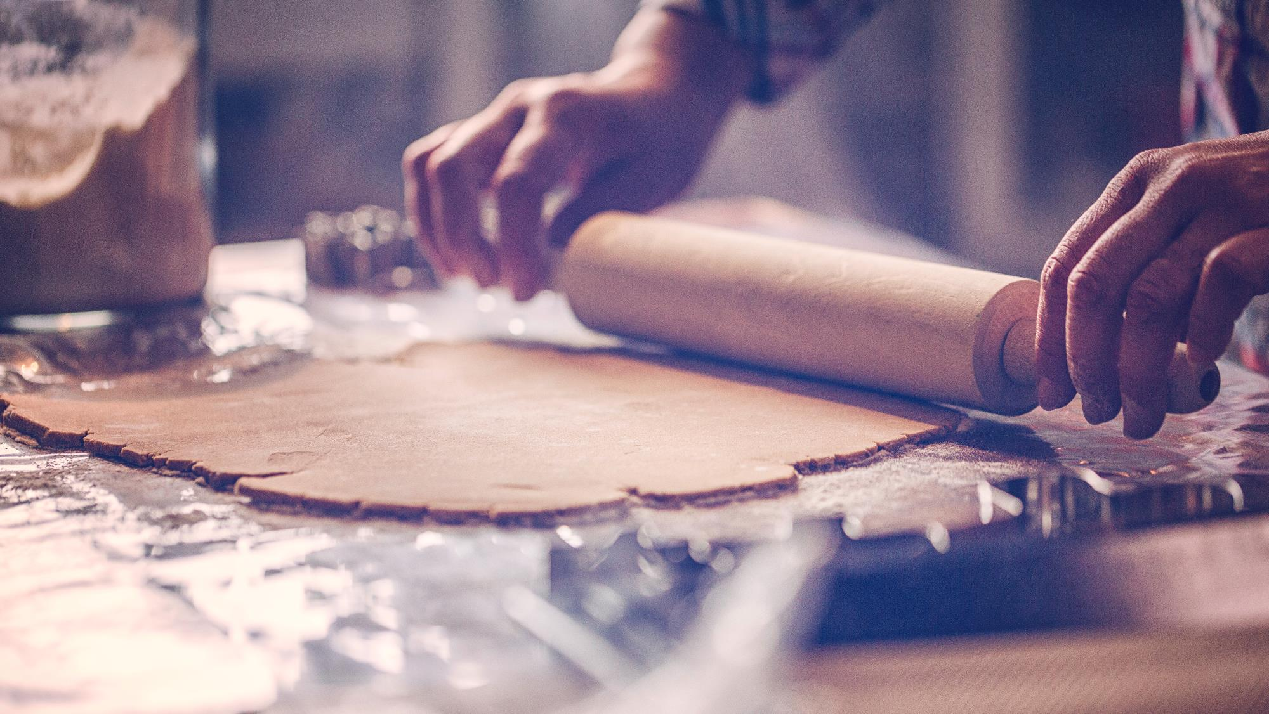

Success keys
Middle rental price
Students and workers clients
Coffee shop among most common venues
Not much competition
Very active place

Slide 12
Conclusion and future directions
The most interesting borough where I can open a coffee shop is Paris 11 because this borough contains the success keys.
According to your target and your budget, it can be interesting for you to open it in another borough.
After this study, to have a more accurate idea before opening your business, we can study what type of coffee shop opens depending on the place.
To answer to this problem we can study for example:
- the client’s review of each coffee shop to see what kind of coffee shops work depending on the clientele and the area.
- the age of the customers attracted according to the kind of coffee shop (working coffee shop with wifi, cosy or other...).

Slide 13

Thank you !
Business owner I hope that this study will help you !

